Slide 1
CHAIR DESIGN
Adnaan Chida

Slide 2
What insight did you gain from your own
reflection and your interview?
1. Height Adjustable chair
2. Office like chair(for computer lab)
3. Cushion
4. Mostly Full black chair
5. Lightweight
6. Sensor for how much back strain
7. Sponge in back rest
8. Rotating chair for viewing and relaxing

Slide 3
what are the two design criteria you are using
when creating your design
Height adjustable and rotatable chair which can be safe to move around with handles in both sides.
Sensor for the user to have data to know how much they have pressure on the chair and the weight distribution on the chair and how straight their back is. NOTE: THE COMPANY WILL NOT COLLECT THE DATA UNLESS THE USER WANTS US TO HAVE THE DATA.

Slide 4
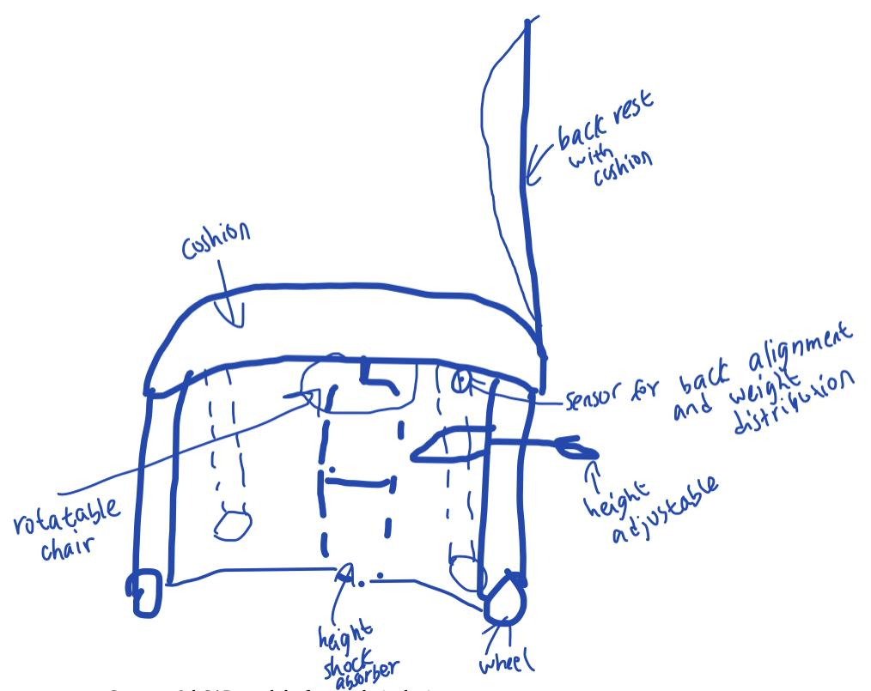
include your sketch

Slide 5
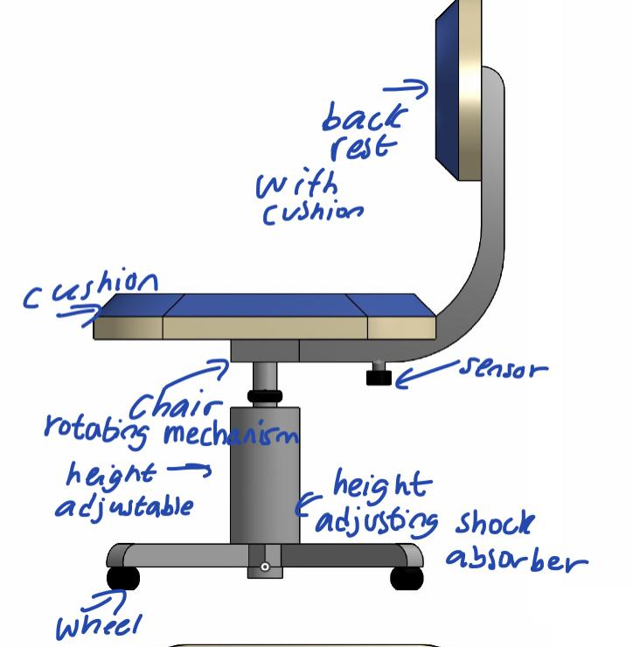
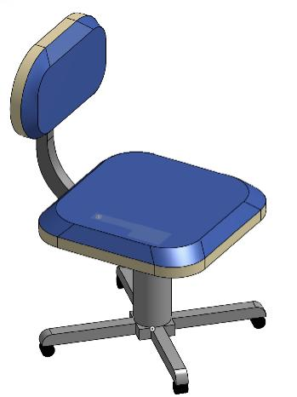
annotated screenshots of your design
highlighting the features you included in the design

Slide 6
what materials do you expect to use in the
manufacturing process? What design choices did you
make to make your design sustainable?
The chair is going to be made mostly of plastic, fabric, battery sensor and wool. Some of the materials will be sustainable but unfortunately some will not. Some of the chosen materials are sustainable while others are not

Slide 7
COST AND ITERATION
The cost of the chair will be approximately $75 - $100. This is still a bit more expensive than traditional chairs but I anticipate that it will sell better.
If I had additional time, I would make maybe a better design and do iteration after iteration, so that it’s better user agrees to it too.

